Slide 1
Computer Science Education CIPS / U of R 2011
Dean Elliott
Science Consultant
Ministry of Education
Notes:
My background – CS teaching, etc.

Slide 2
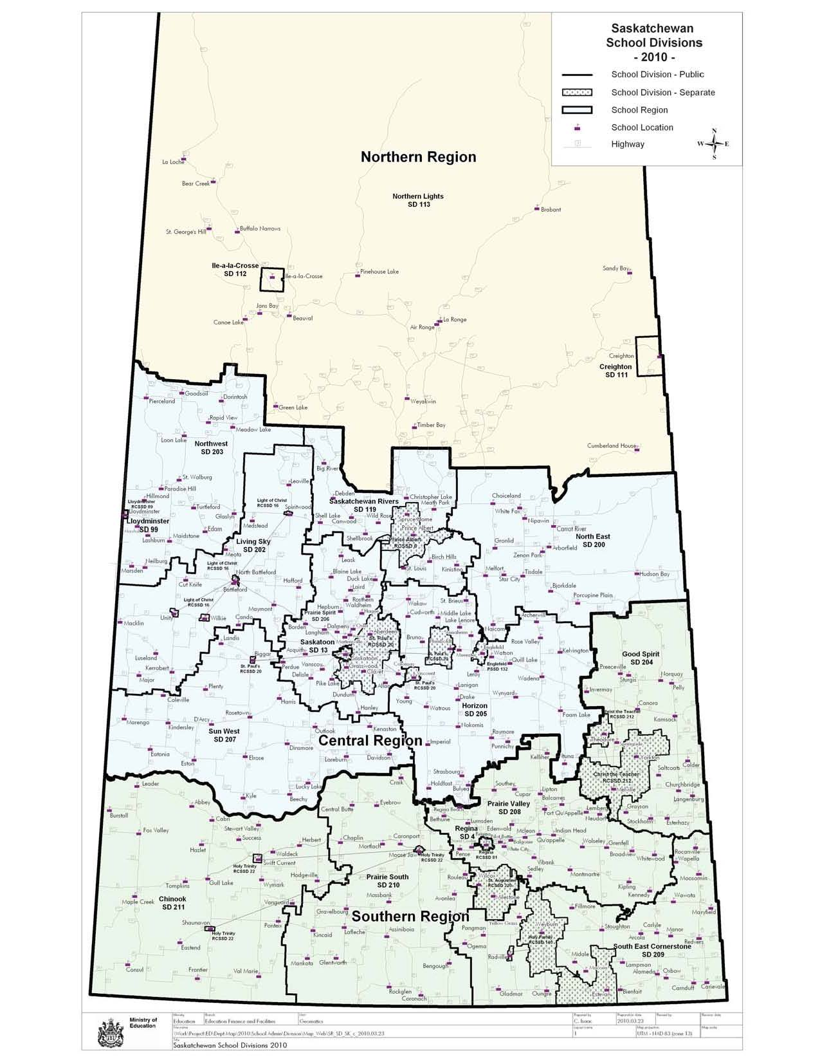
School Divisions
18 public
125,000 / 600
8 separate
35,000 / 120
1 francophone
1,100 / 1
1 protestant
105 / 1

Slide 3
SK Core Curriculum
Required Areas of Study
Language arts
Mathematics
Science
Social studies
Health education
Arts education
Physical education
Common Essential Learnings
Locally-determined Options
Adaptive Dimension
Notes:
Required Areas of Study
- language arts
- mathematics
- science
- social studies
- health education
- arts education
- physical education
Locally determined Options
Adaptive Dimension
- teachers should adapt instruction, learning environment, curriculum materials and topics to help all students achieve curriculum objectives

Slide 4
Senior Science Courses
Physics 20
Biology 20
Chemistry 20
Computer Science 20
Physics 30 *
Biology 30
Chemistry 30 *
Computer Science 30 *
GRADUATION REQUIREMENTS
Science 10
1 20- or 30-level science

Slide 5
Secondary Science Enrolment

Slide 6
CS 20/30 Enrolment

Slide 7
CS 20/30 Number of Schools

Slide 8
Enrolment by Gender

Slide 9
Computer Science Courses
CS 20/30
Developed in 1999 as a science elective
Not language specific
Qbasic, Php, javascript, .NET, python, scratch
Advanced Placement Computer Science
Industry certification

Slide 10
Practical and Applied Arts
Information Processing 10, 20, 30 (3603, 1255, 978)
Productivity tools, desktop publishing, digital photography, computer technology
Computer Networking 10L, 20L, 30L (24, 7, 0)
Computer Animation 20L (10)
Computer Programming 30L (3)
Robotics 20L (30)

Slide 11
Computer Science 20 Outline
Unit | Suggested Hours
Software and Hardware | 5-10
Problem Solving | 5-10
Fundamentals of Programming and Design | 5-10
Experience with Programming and Design | 50-65
Networks (Optional) | 5
Careers Related to Computer Science | 5
Research Topics | 7-10

Slide 12
Computer Science 30 Outline
Unit | Suggested Hours
Software and Hardware – Advanced | 2-3
Problem Solving – Advanced | 3-4
Problem Solving and Programming | 3-4
Experience with Programming and Design – Advanced | 50-65
Number Systems and Codes (Optional) | 5-8
Impact of Information Technology | 3-5
Programming for Applications | 3-4
Internet and Multimedia (Optional) | 4-6
Research Topics | 7-10

Slide 13
Research Topics
Architecture
AI
CADD/CAM
Computer Technology
Computing Systems
Creative Problem Solving
Documentation
Future Studies
Gaming
Information Storage and Retrieval
Office Automation
Project
Process Control
Programming Topics: Advanced
Robotics
Security
Special Needs
Systems Analysis
Trends and Issues
User Interfaces

Slide 14
Future Directions
Renewed CS 20 / 30
On-line course
Resources / supports
ACM/CSTA K-12 Computer Science Standards
Other jurisdictions courses

Slide 15
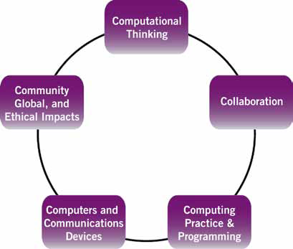
CSTA K-12 Strands

Slide 16
Stakeholder Participation
Support curriculum development
Professional development for teachers
Resources for teachers / students
Programming day
Career information / speakers / tours
Advocacy
Notes:
E.g. CS programming day in Saskatoon

Slide 17
Contact Information
Dean Elliott
Science Consultant
Ministry of Education
dean.elliott@gov.sk.ca
787-6765

